Slide 1

Report

Slide 2
Project Goals
Root
Root Cause Analysis: Investigate common customer complaints. Pinpoint recurring problems to address them proactively and prevent future escalations.
Analyze
Service Response Time Analysis: Analyze response times for customer queries and support requests to assess the efficiency of the customer service team
Segment
Customer Segmentation: Segment customers based on their demographics, behaviour, and preferences
Identify
Trends and Patterns Identification: Identify patterns and trends in customer service data to uncover opportunities for process improvements and innovative service offerings
Perform
Customer Sentiment Analysis: Perform sentiment analysis on customer interactions. Identify positive, negative, and neutral sentiments expressed by customers to understand overall satisfaction levels.

Slide 3
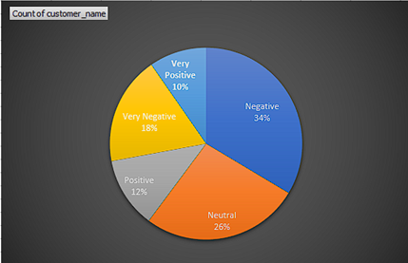
Customer Sentiment Analysis
Suggestions to decrease the negative Sentiment -:
Encourage delegates to use polite language. For example, they might say, "Let's see how I can help."
Processes such as acknowledging the customer's complaint, apologizing, and offering solutions can be very effective.
This helps them deliver the right message quickly, reducing customer and repeat frustrations.
Customers appreciate honesty and are more understanding when they know what they want.

Slide 4
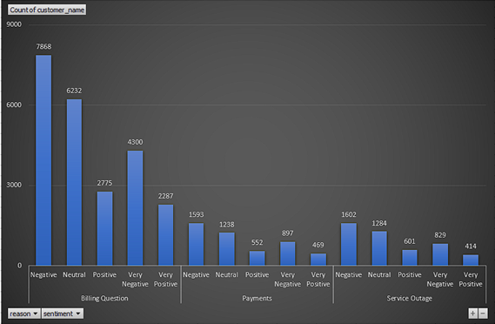
Root Cause Analysis
Suggestions to reduce negative sentiment for each reason-:
Provide extensive training on billing processes, common billing issues, and how to effectively explain billing details to customers.
Equip representatives with knowledge of common billing errors and how to rectify them.
Offer various payment methods to accommodate different customer preferences, such as credit/debit cards, bank transfers, online payment platforms, and payment plans.
Provide flexibility in due dates or offer automatic payment options to prevent missed payments.
Offer round-the-clock support during service outages to assist customers and provide real-time updates.
Ensure that representatives are trained to handle high call volumes during outage situations.

Slide 5
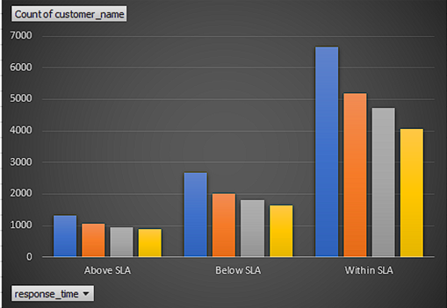
Service Response Time Analysis
Suggestions to reduce response time-:
Ensure that staffing levels are appropriate to handle call volumes efficiently. Analyze historical data to predict peak call times and adjust staffing accordingly.
Implement flexible scheduling to have more agents available during peak hours
Implement a call prioritization system based on the nature of the call. Urgent or high-priority calls should be handled first.
Use call routing technology to direct calls to the most appropriate agents based on skillset and availability.
Utilize call queuing systems to hold callers in a queue until an agent becomes available.
Provide estimated wait times to manage caller expectations and reduce frustration.

Slide 6
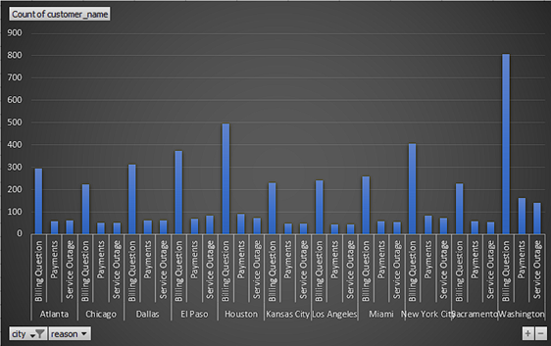
Customer Segmentation
Suggestions
Segment Customers based on the Gender as Different genders may have different preferences or Needs
Segment customers based on where they are in the customer lifecycle, such as prospects, new customers, active customers, or lapsed customers.

Slide 7
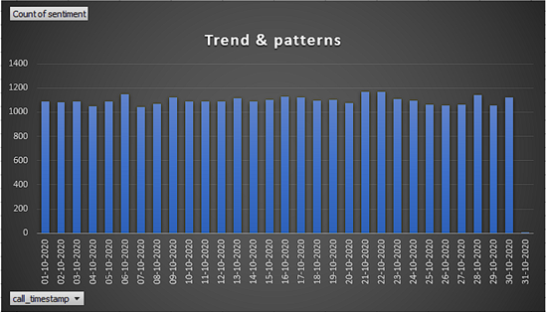
Trends and Patterns Identification
Suggestions
Analyze call volume patterns over different time periods (daily, weekly, monthly, seasonal) to identify peak times and plan staffing accordingly.
Categorize calls based on the reason for contact (e.g., billing inquiries, technical support, product information).
Use data insights to implement preventive measures and reduce the recurrence of issues.
Monitor trends in SLA compliance to ensure that service level targets are being met.

Slide 8
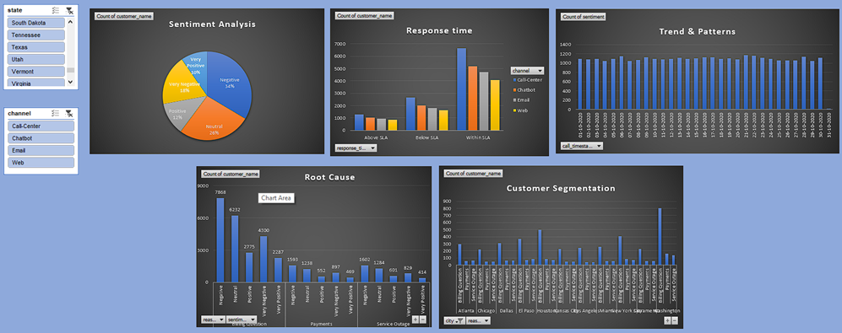
Final Report

Slide 9
Thank You

